Slide 1
Julia – JuMP Tutorial

Slide 2
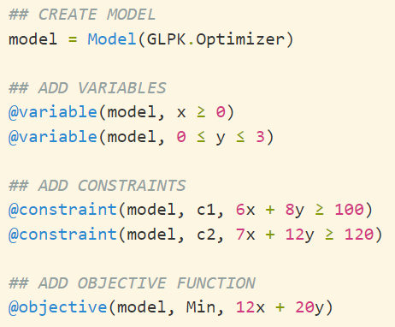
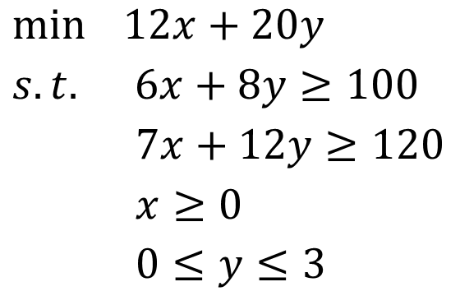
LP Example
$\min{ 12x+20y}$
$s.t. 6x+8y≥100$
$7x+12y≥120$
$x≥0$
$0≤y≤3$

Slide 3
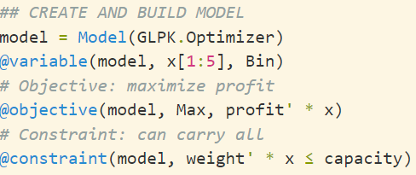
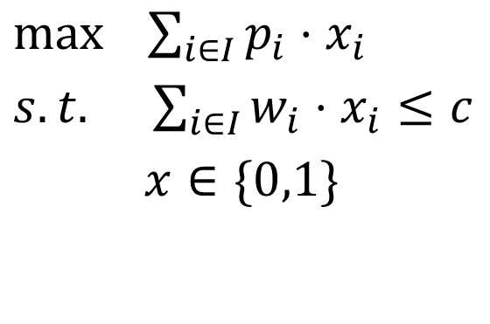
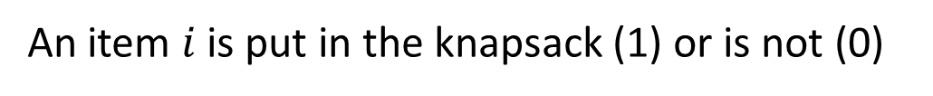
Knapsack Problem
$\max{ \sum_{i∈I}{p_{i}⋅x_{i}}}$
$s.t. \sum_{i∈I}{w_{i}⋅x_{i}}≤c$
$x∈\{0,1\}$
Maximize profit (value) of the knapsack
Enforce capacity (weight) limits
An item $i$ is put in the knapsack (1) or is not (0)

Slide 4
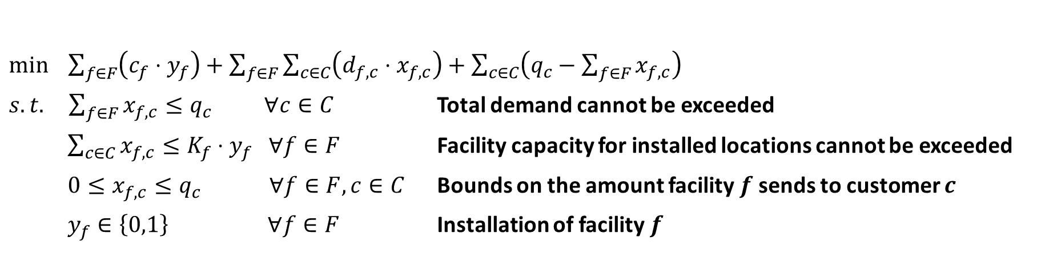
Facility Location Problem
Fixed installation Cost
Transportation cost
Unmet demand

Slide 5
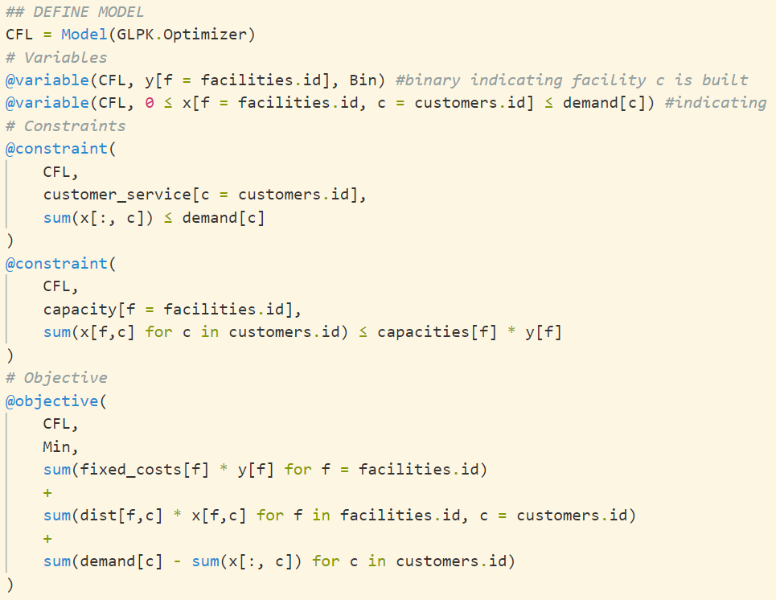
Facility Location Problem

